Slide 1
<Introduction>
Presentation “Plugin”
Note: this is not a separate presentation – this is just a fragment that can’t be presented separately to the customer; it should be included in a more general presentation (or presentation framework) that has the intro, agenda, ending and more…
Document date: <YYYY-MM-DD>
Document Author: <Johan Johansson>
Related WWW Page: www.Novacura.com/…
QMS-TM09b

Slide 2
introduction

Slide 3
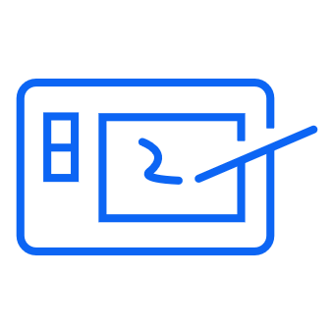
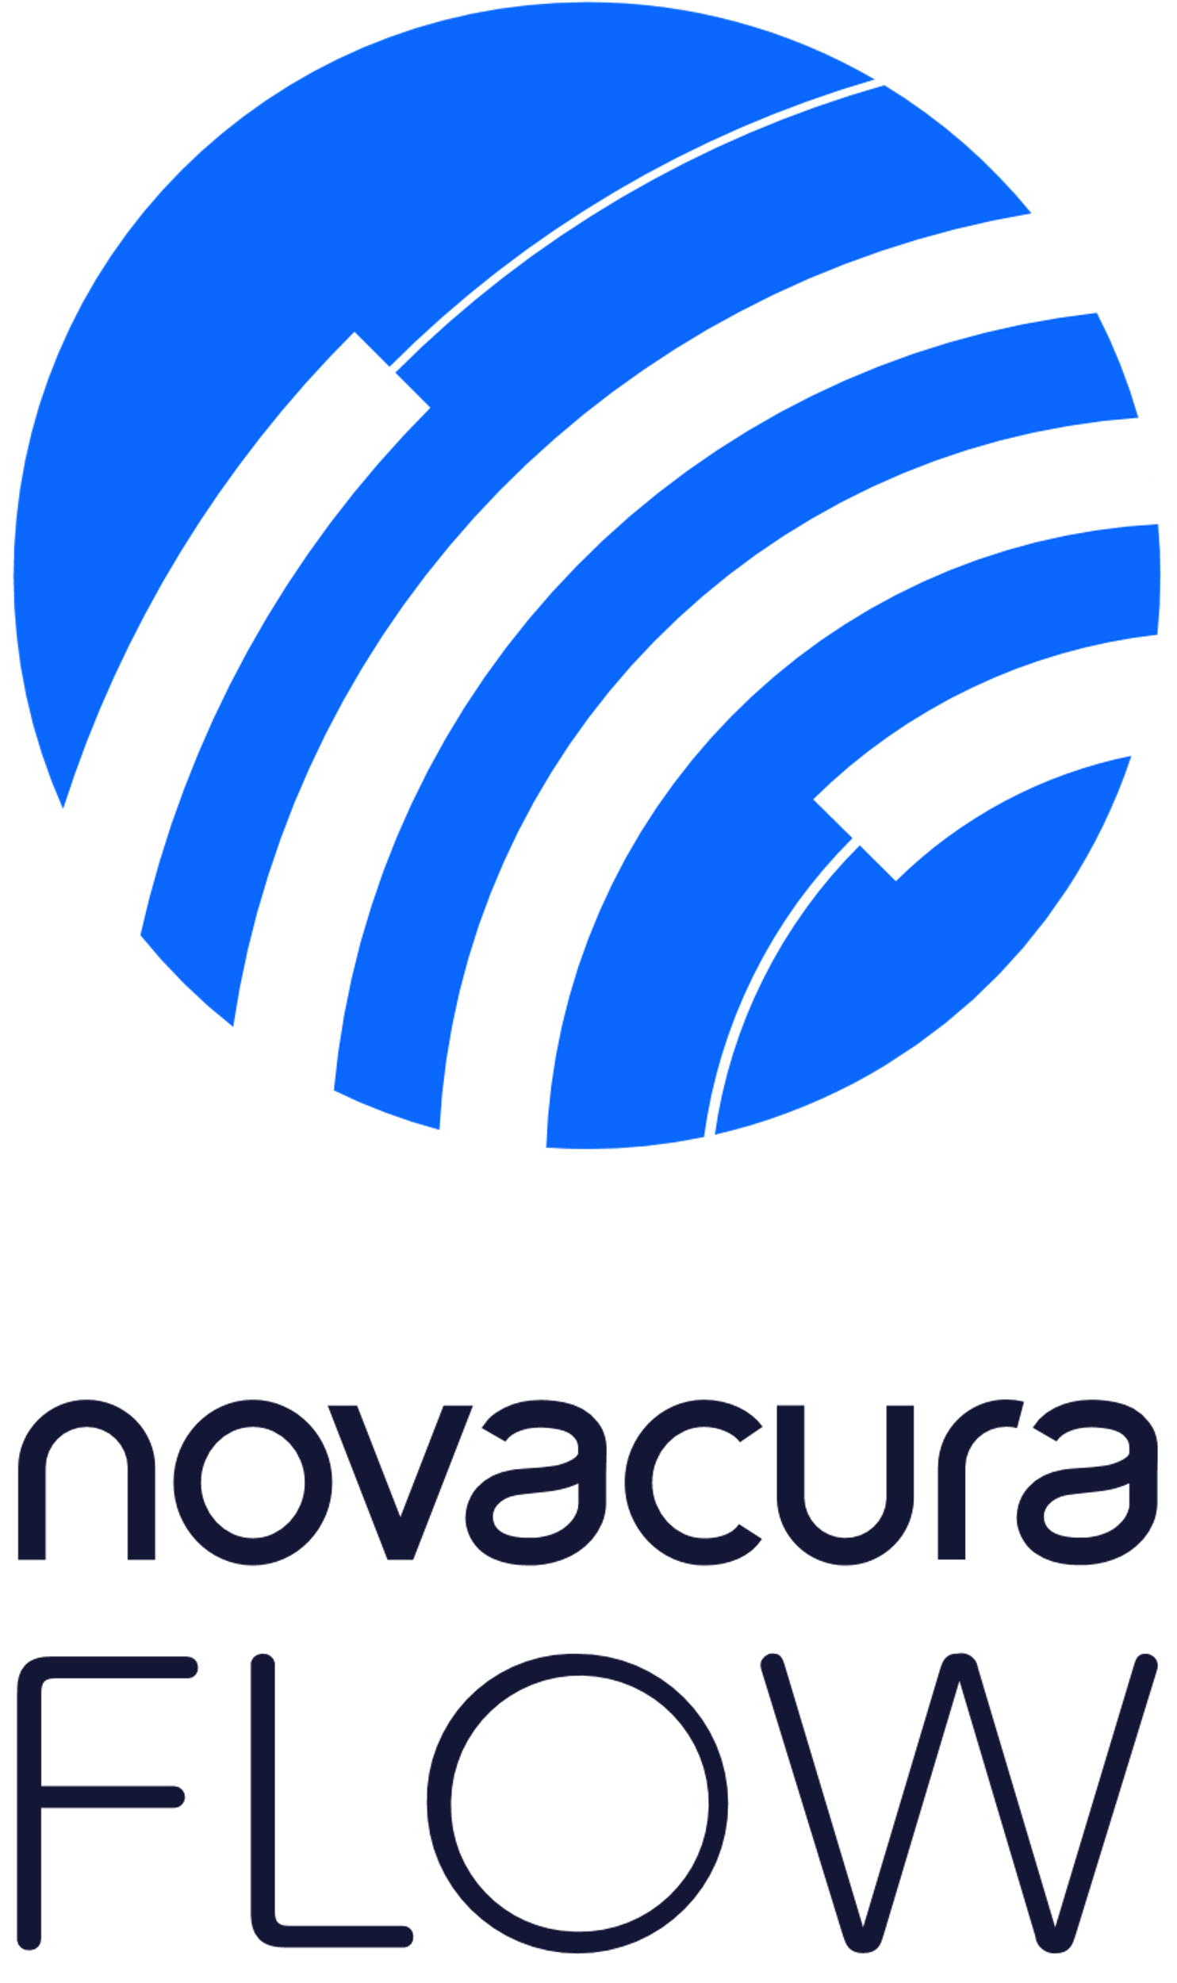
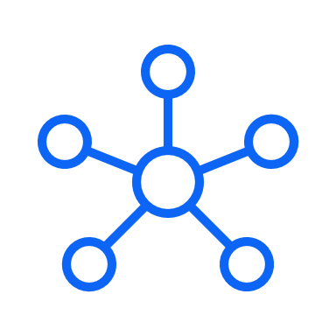
LOW-CODE DEDICATED TO EXPANDING ERP SYSTEMS
Novacura Flow is a versatile software suite that helps modify and widely expand ERP systems. Novacura Flow is basically a low-code platform, where customers can build their own ERP applications by simply drawing them in a specific app designer.
Low-code platform
+
+
Integration engine
Process management
+
It all, together with end-user applications that run on every device and the library of industry applications available in the Novacura Marketplace, makes Novacura Flow the most complete software package to eliminate the limitations of ERP systems.

Slide 4
DISCOVER OUR
CAPABILITIES

Slide 5
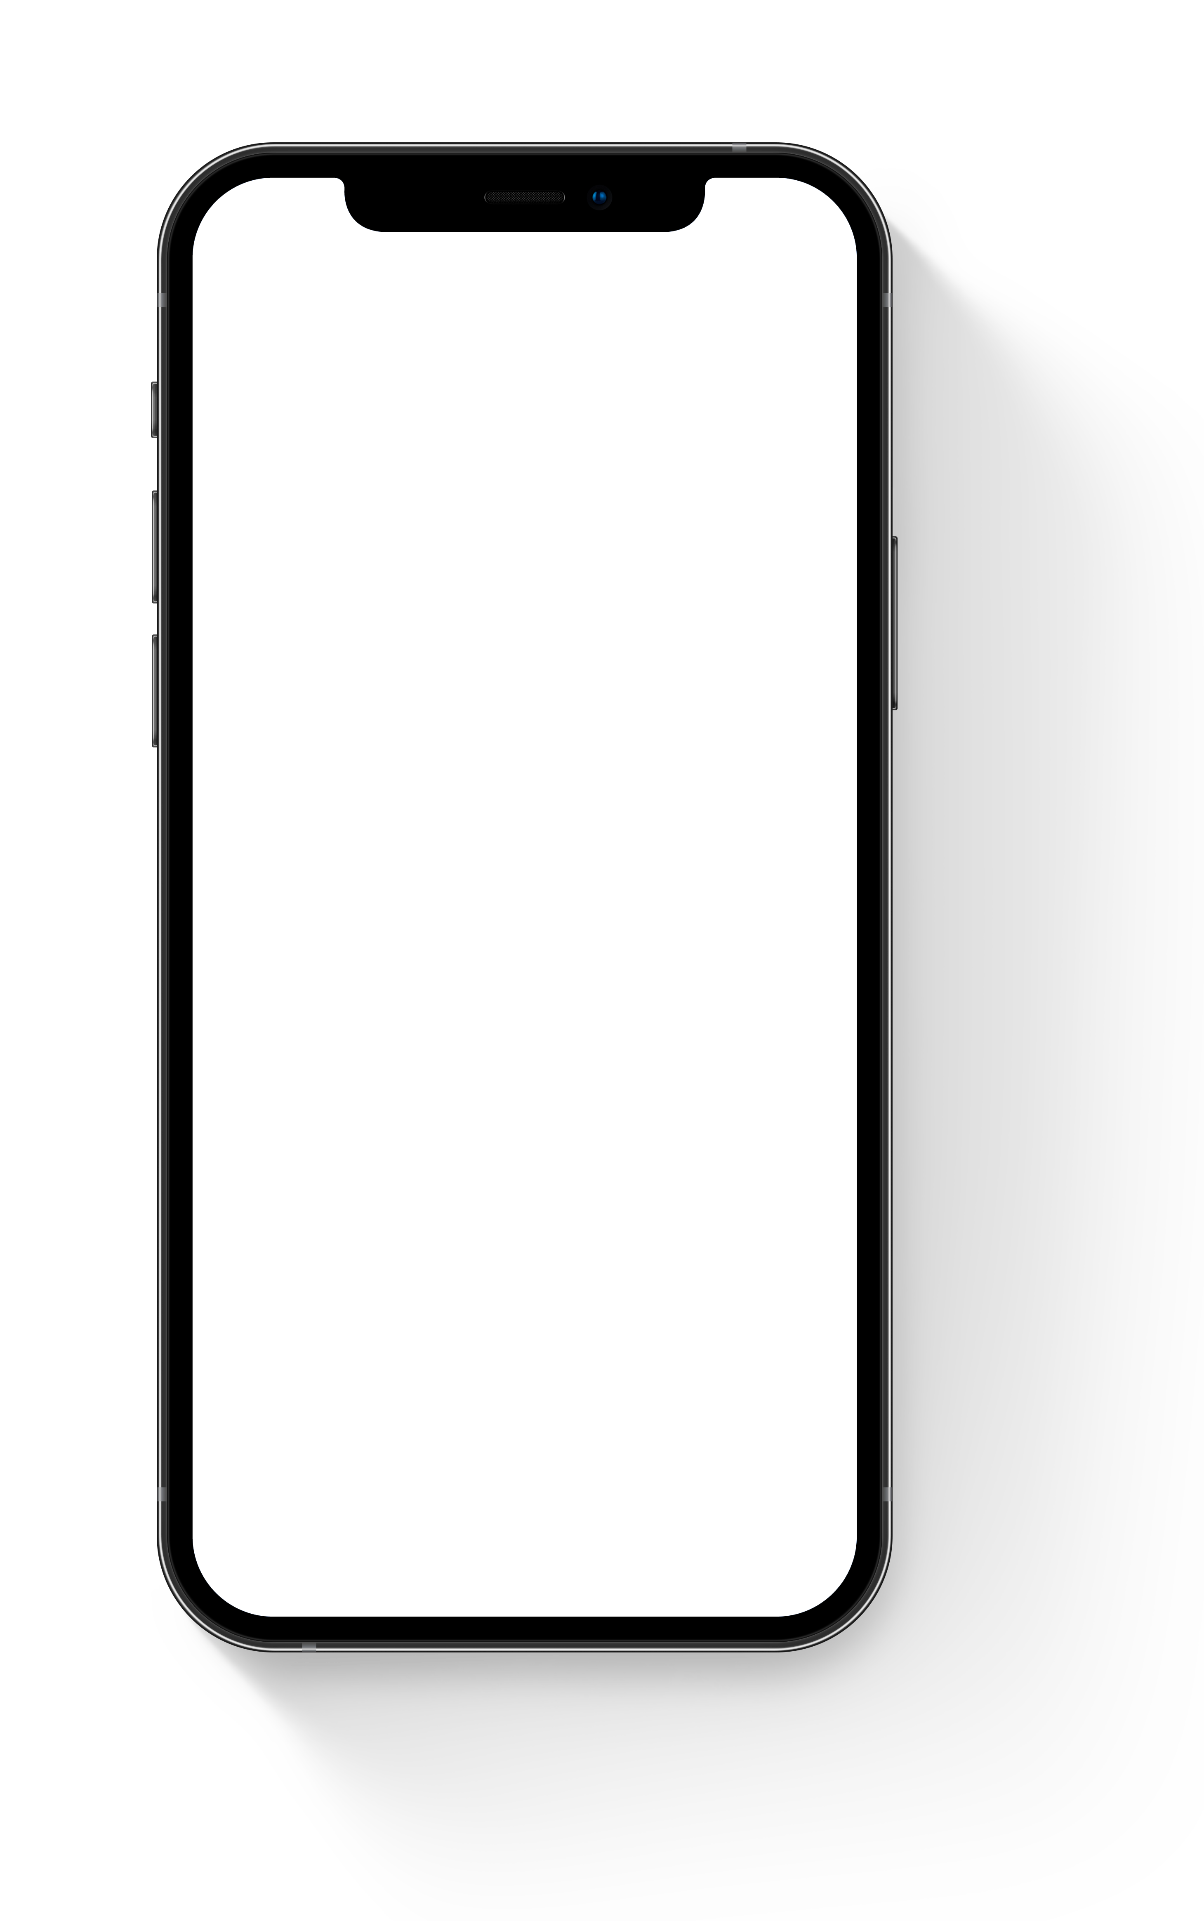



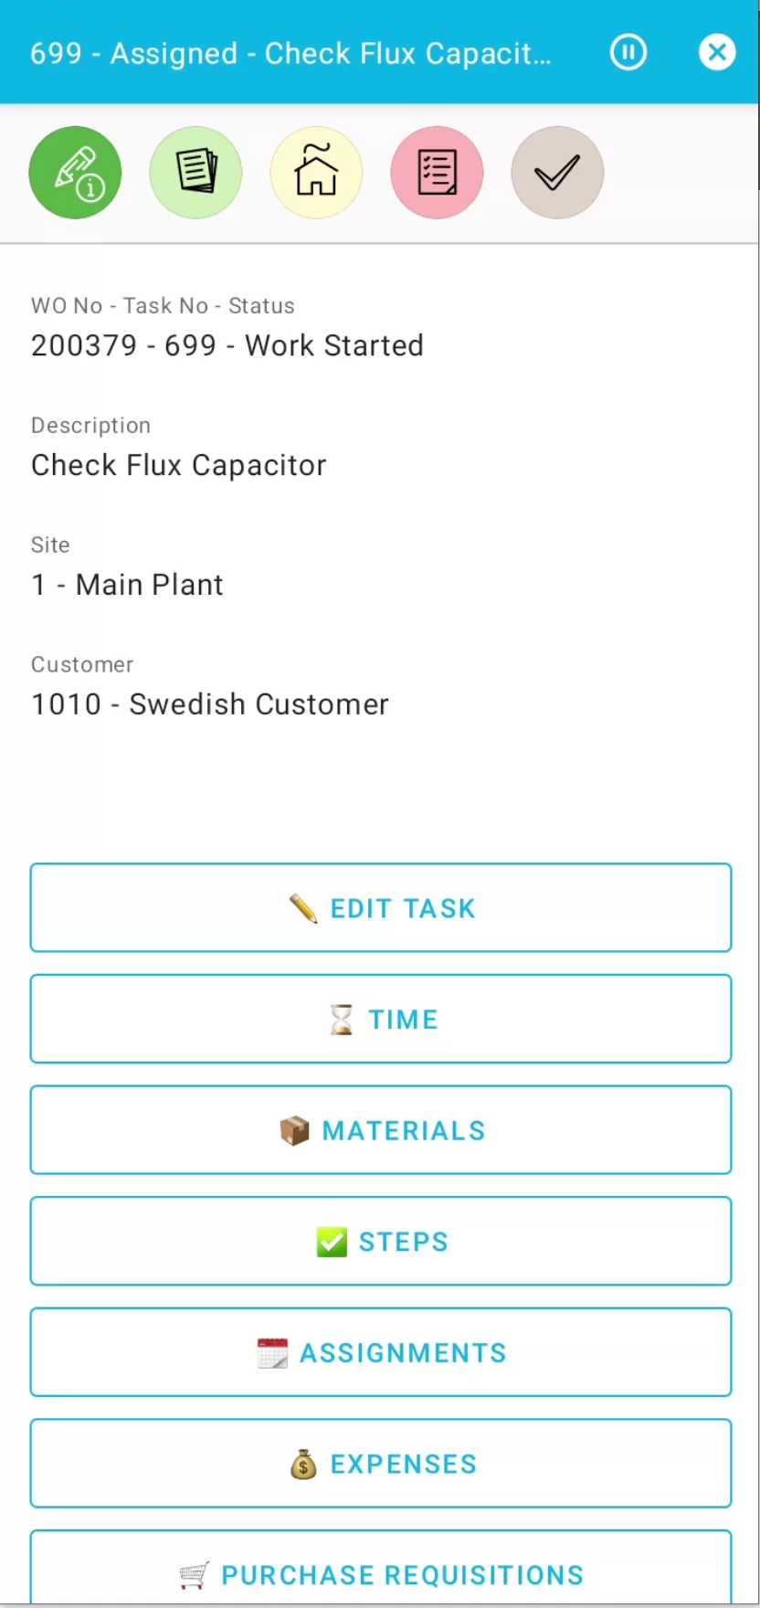
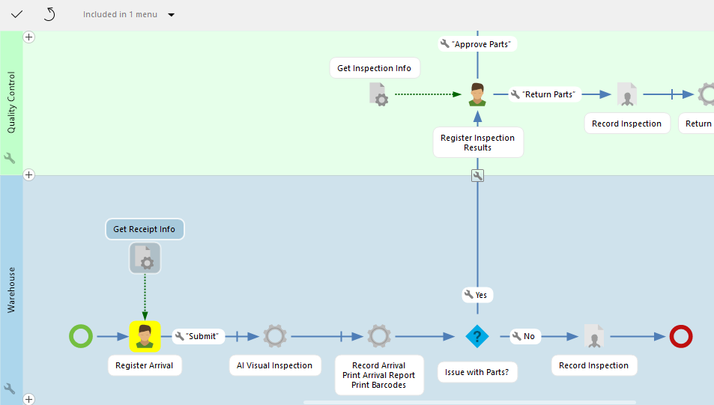
01. ERP applications builder with low-code philosophy
Image
09:09
In low-code platform, all applications are created in a specific application designer (Novacura Flow Studio).
Designers can create apps by drawing processes supported by the application.
Designers can also easily communicate with the ERP system by using a dedicated ERP connector. Then, with just one click, they can publish the application for the end-users so that users can use it on various devices.
Notes:
In Novacura Flow, Production management and Maintenance management are parts of the same manufacturing solution. The service team can fit maintenance activities into production plans, even if they change every hour. Moreover, whenever downtime is identified on the shop floor, the maintenance team can be automatically notified in the mobile application and start activities before the machine operator starts calling for help. That will help reduce MTW.

Slide 6

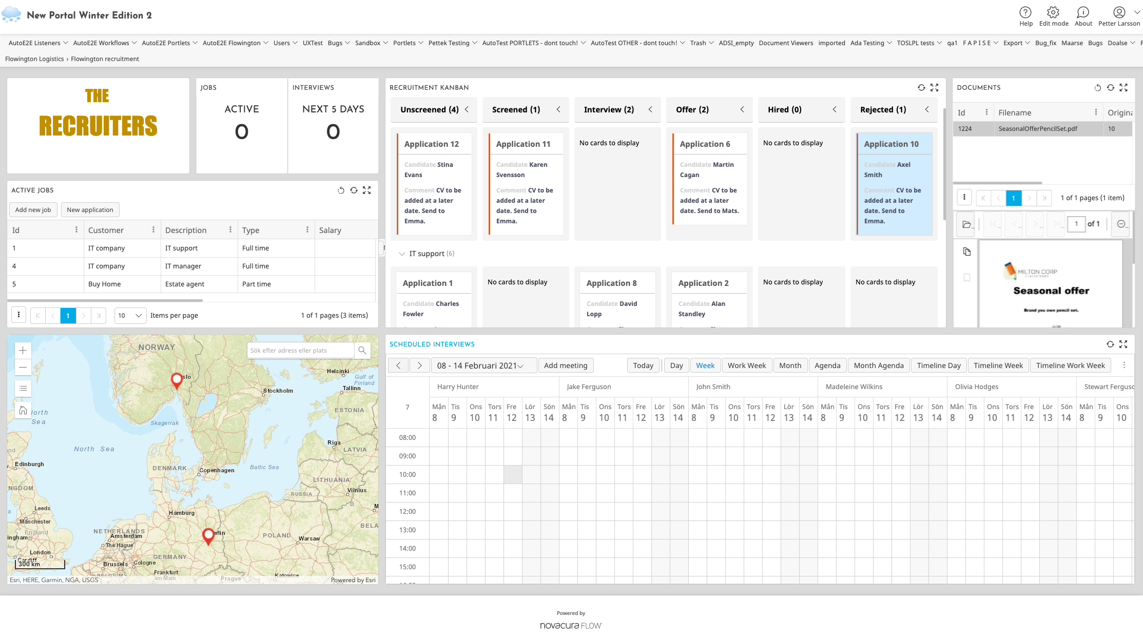

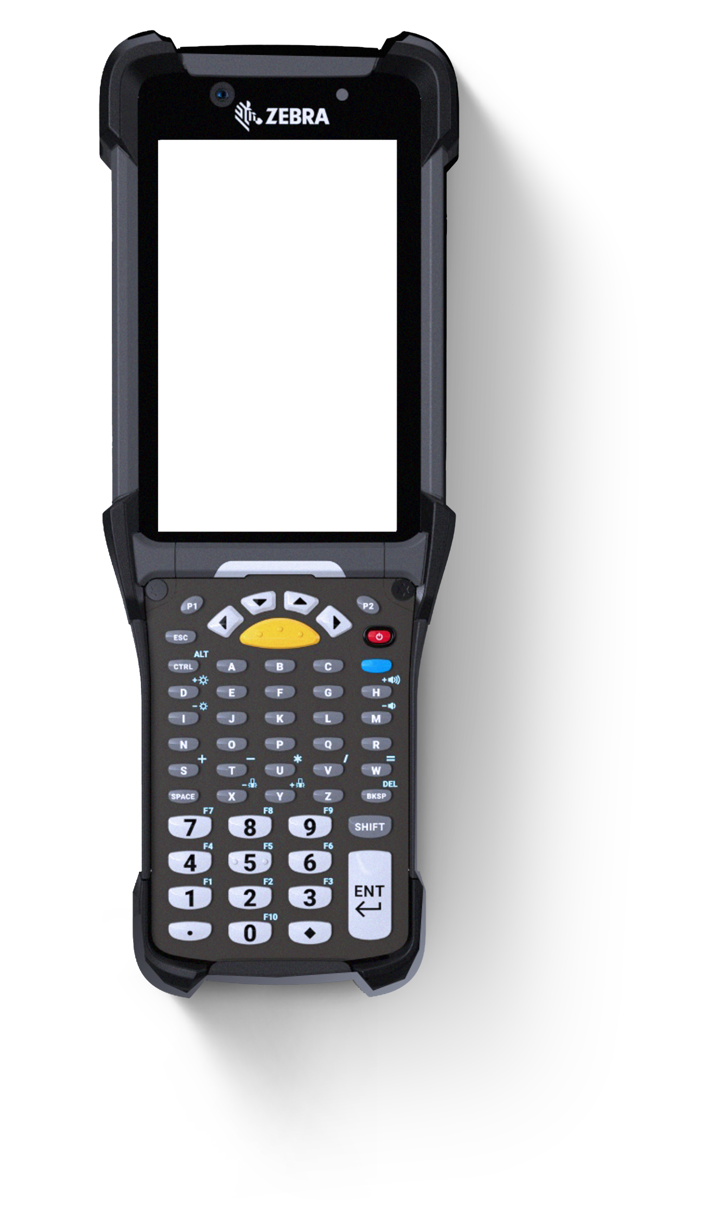
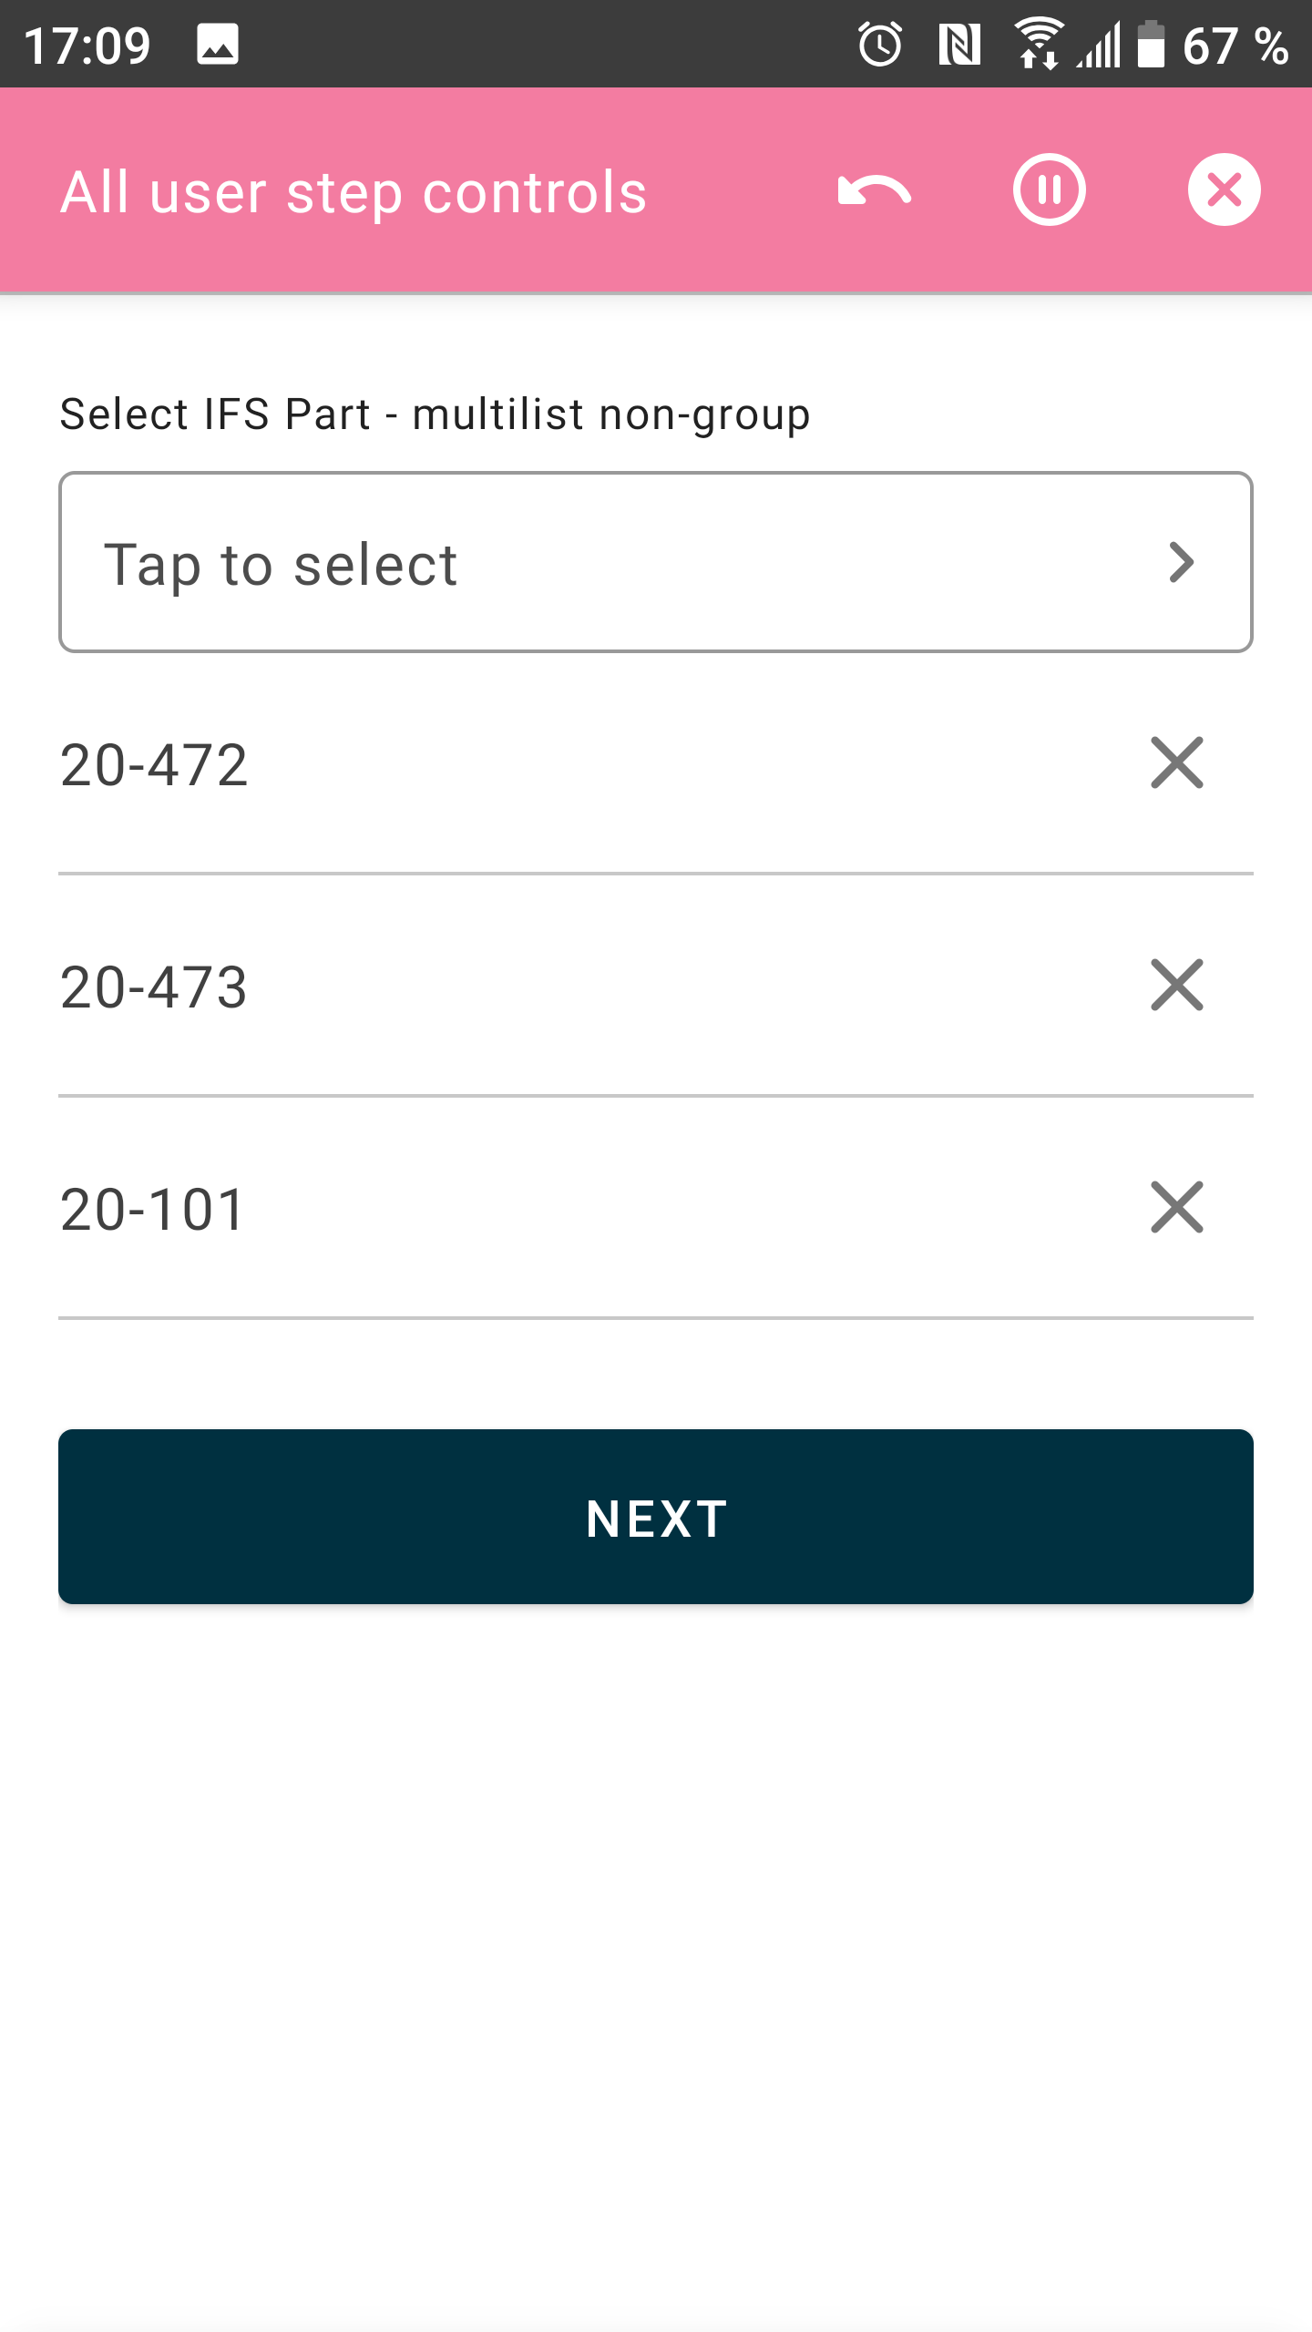
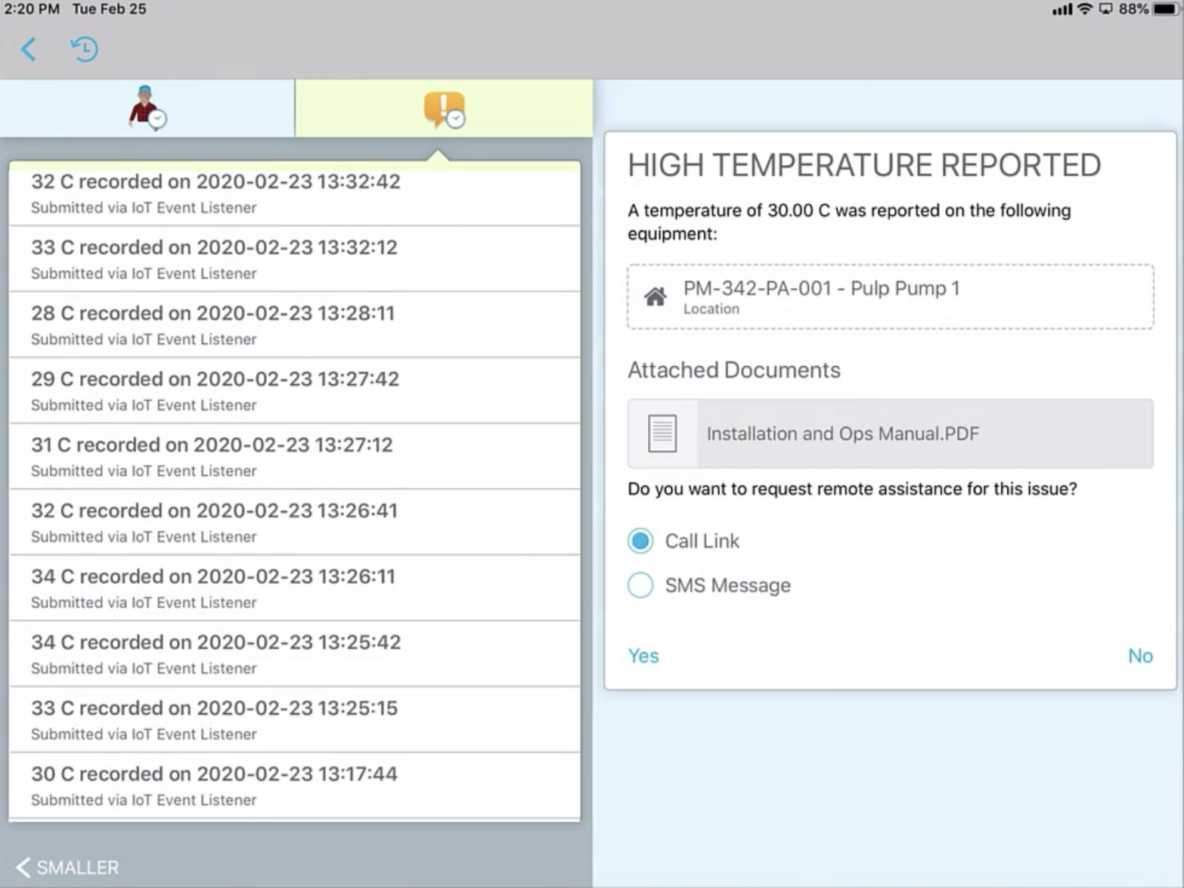
02. User interface for every type of user
Applications created in Novacura Flow can be run on any device type: mobile phones, tablets, and desktops (as a web-based application).
Applications can even be used on barcode scanners. Our mobile user interface is simple and optimized to be clicked a thousand times per hour (i.e. to report logistic operations).
Novacura Flow offers a sophisticated web-portal interface, that is perfect for presenting dashboards, reports or performing complex operations like planning and scheduling.
Image
09:09
Notes:
In Novacura Flow, Production management and Maintenance management are parts of the same manufacturing solution. The service team can fit maintenance activities into production plans, even if they change every hour. Moreover, whenever downtime is identified on the shop floor, the maintenance team can be automatically notified in the mobile application and start activities before the machine operator starts calling for help. That will help reduce MTW.

Slide 7
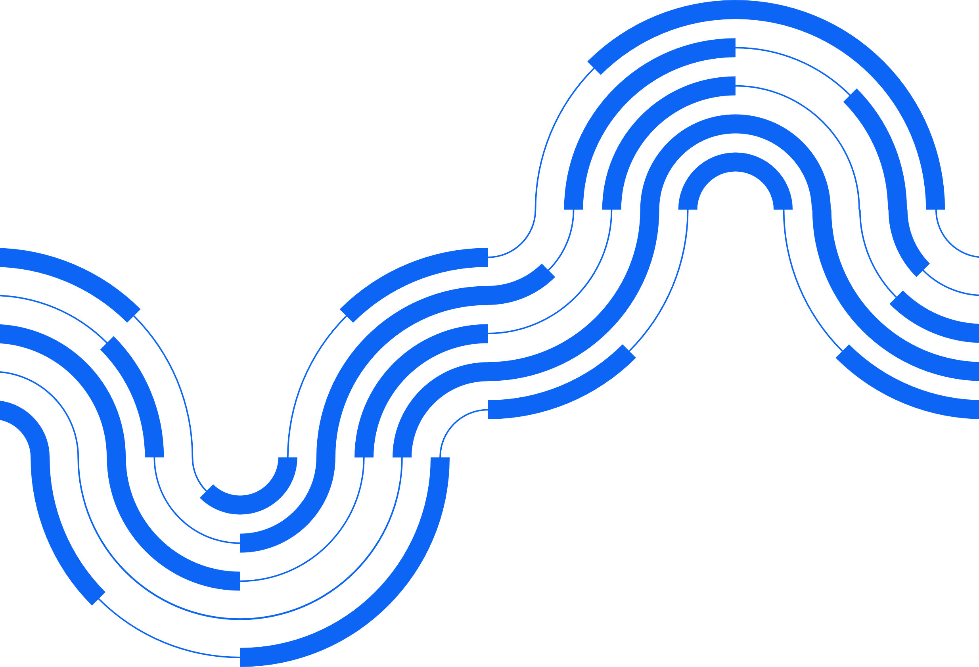

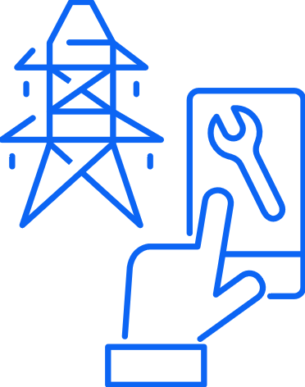

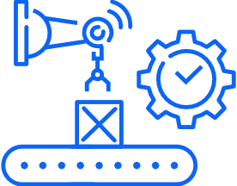
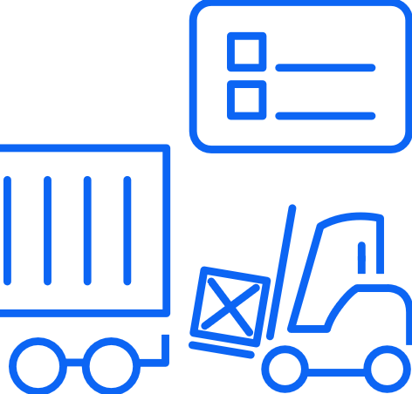


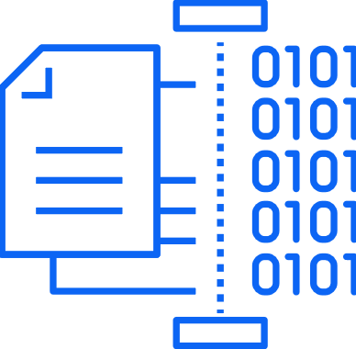





03. Dedicated features supporting the most demanding industries
Novacura Flow goes beyond the air-conditioned offices. It offers specific features (like barcodes support, offline mode, and mobile printing) so it can easily act in a warehouse, on a shop floor, or out in the field.
WORKS IN ALL DEPARTMENTS
Notes:
In Novacura Flow, Production management and Maintenance management are parts of the same manufacturing solution. The service team can fit maintenance activities into production plans, even if they change every hour. Moreover, whenever downtime is identified on the shop floor, the maintenance team can be automatically notified in the mobile application and start activities before the machine operator starts calling for help. That will help reduce MTW.

Slide 8
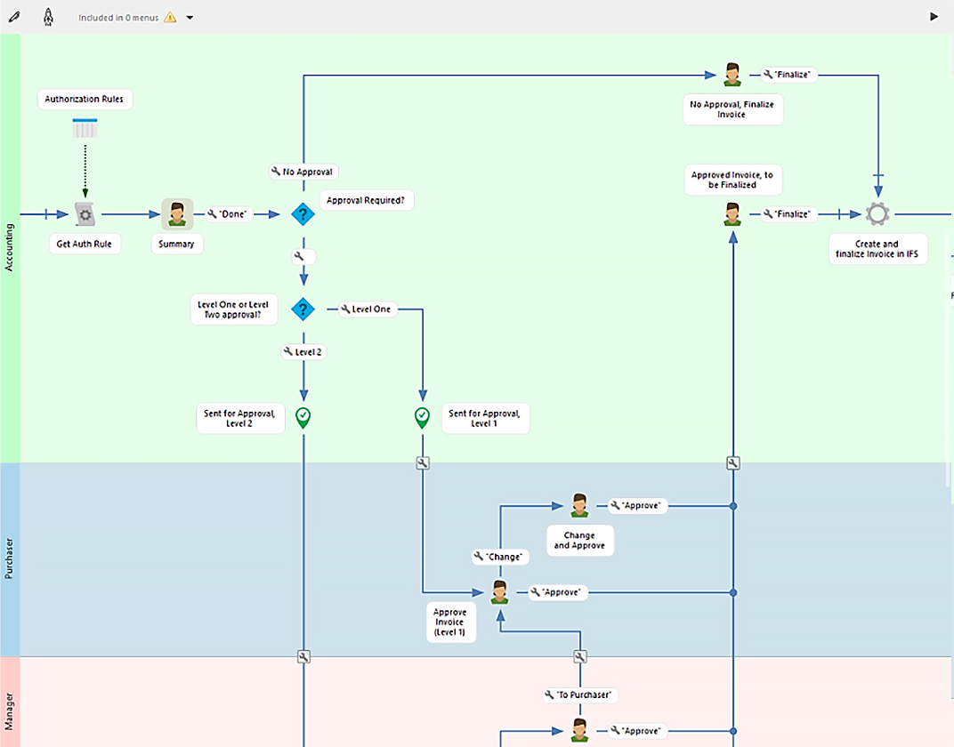
04. process management (BPM)
Novacura Flow applications are created in a graphical way.
All application steps (user interaction, data operations, connectivity with other systems etc.) are connected in a workflow that represents a business process.
Novacura Flow can be used as a process layer for the ERP and can control complex processes that involve different people, systems, and various modules of the ERP.
Novacura Flow you optimize processes by gathering stats and measuring them.
Notes:
In Novacura Flow, Production management and Maintenance management are parts of the same manufacturing solution. The service team can fit maintenance activities into production plans, even if they change every hour. Moreover, whenever downtime is identified on the shop floor, the maintenance team can be automatically notified in the mobile application and start activities before the machine operator starts calling for help. That will help reduce MTW.

Slide 9

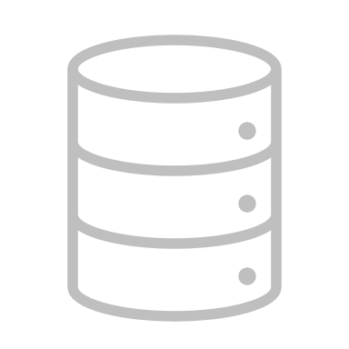
05. Deep ERP Integration
Novacura Flow is not just another low-code platform.
Primary design assumption is that it must work seamlessly with the most popular ERP systems.
Novacura Flow is equipped with dedicated ERP connectors, that use only official ERP APIs to get access to ERP data and functions offered by ERP.
Connectors can be easily configured and used in applications created in Novacura Flow.
ERP system
Notes:
In Novacura Flow, Production management and Maintenance management are parts of the same manufacturing solution. The service team can fit maintenance activities into production plans, even if they change every hour. Moreover, whenever downtime is identified on the shop floor, the maintenance team can be automatically notified in the mobile application and start activities before the machine operator starts calling for help. That will help reduce MTW.

Slide 10



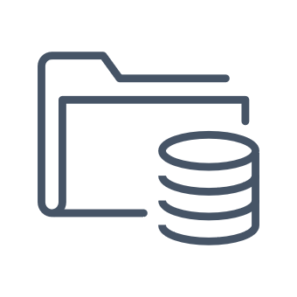
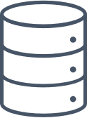
06. Integration platform capabilities
ERP
Novacura Flow can act as an integration platform. It is equipped with 50+ connectors to the most popular business systems, cloud platforms and cloud services.
Novacura Flow applications can orchestrate the integration between multiple systems.
Novacura Flow application can be called by an external system as a web-service – so Novacura Flow can act as a service bus.
eCommerce
CRM
(i.e. Salesforce, Hubspot)
Project Management
(i.e. Primavera)
Collaboration
(i.e Office 365)
Other ERP
Notes:
In Novacura Flow, Production management and Maintenance management are parts of the same manufacturing solution. The service team can fit maintenance activities into production plans, even if they change every hour. Moreover, whenever downtime is identified on the shop floor, the maintenance team can be automatically notified in the mobile application and start activities before the machine operator starts calling for help. That will help reduce MTW.

Slide 11

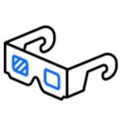

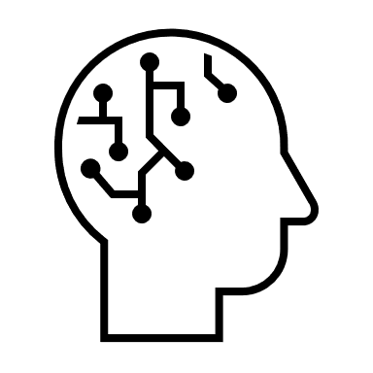
07. Technology bridge for the ERP
ERP
Novacura Flow can be used as a bridge to the latest technologies for the ERP system.
It offers connectivity to cloud services like Artificial intelligence (AI), Document recognition, Computer vision, or Augmented reality.
It supports physical equipment integration, which is important for specific industries.
It can be connected to gauges, machines, robots or vehicles.
Computing cloud
Augmented Reality
IoT
Artificial Intelligence
Notes:
In Novacura Flow, Production management and Maintenance management are parts of the same manufacturing solution. The service team can fit maintenance activities into production plans, even if they change every hour. Moreover, whenever downtime is identified on the shop floor, the maintenance team can be automatically notified in the mobile application and start activities before the machine operator starts calling for help. That will help reduce MTW.

Slide 12

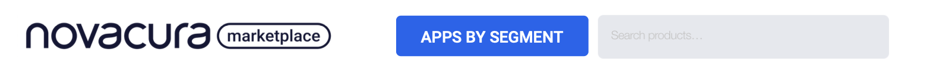
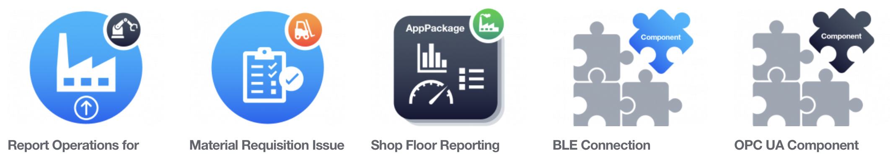
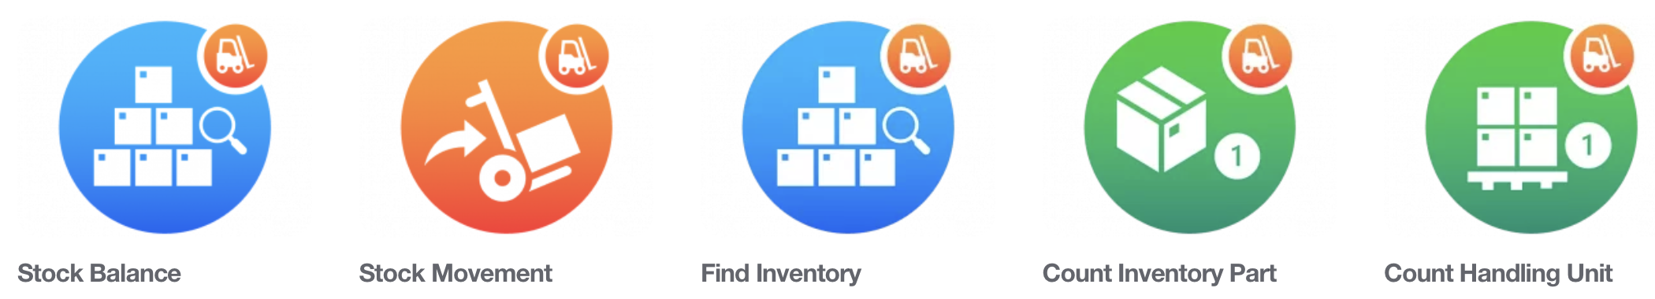
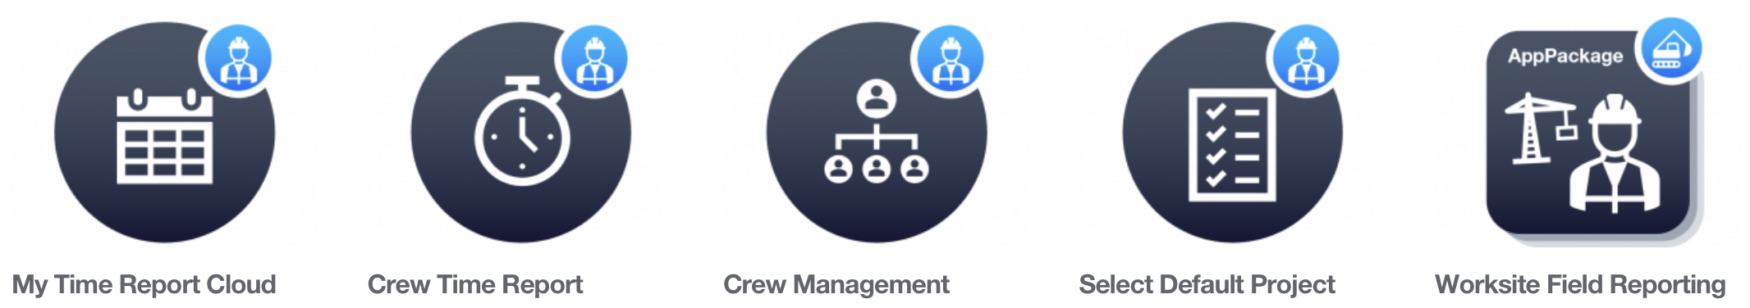
08. Library of applications and components
Novacura Flow is a next-generation low-code platform, where you don’t need to create applications from scratch.
Thanks to our marketplace, you get access to dozens of ERP applications prepared to meet your industry needs.
You can also use these apps as great examples on how to interact with the ERP or other systems. It all helps IT to react quicker to the needs that come from the business!
Notes:
In Novacura Flow, Production management and Maintenance management are parts of the same manufacturing solution. The service team can fit maintenance activities into production plans, even if they change every hour. Moreover, whenever downtime is identified on the shop floor, the maintenance team can be automatically notified in the mobile application and start activities before the machine operator starts calling for help. That will help reduce MTW.

Slide 13


09. Avoid ERP modifications
Thanks to deep ERP integration, you can treat Novacura Flow as an alternative user interface for the ERP.
You can implement all additional requirements for the ERP as Novacura Flow applications, and keep the ERP free of modifications.
It gives you better evidence of “customizations” and you don´t need to recreate modifications when upgrading the ERP. This really helps to implement an “evergreen ERP” strategy.
Modifications Free ERP
Notes:
In Novacura Flow, Production management and Maintenance management are parts of the same manufacturing solution. The service team can fit maintenance activities into production plans, even if they change every hour. Moreover, whenever downtime is identified on the shop floor, the maintenance team can be automatically notified in the mobile application and start activities before the machine operator starts calling for help. That will help reduce MTW.

Slide 14
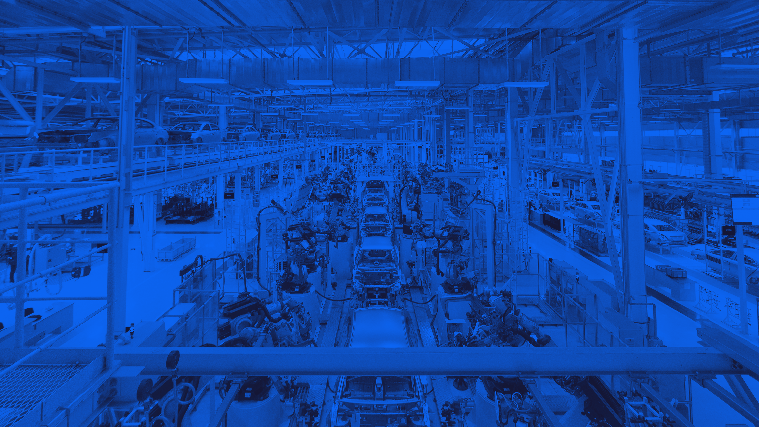


<SLOGAN TITLE>
<SLOGAN SUBTITLE>
<SLOGAN TITLE>
NOVACURA FLOW FILLS
ERP GAPS
Example style for slogans

Slide 15
NOVACURA FLOW FILLS
ERP GAPS
Popular ERP systems have one common problem: they try to be equally good for all companies.
We know that every business is unique and needs specific solutions.
With Novacura Flow, you can create specific ERP applications that will expand the standard capabilities of your ERP system.:

Slide 16
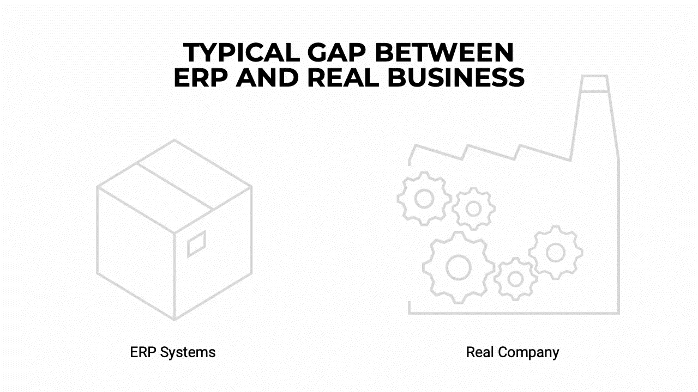
NOVACURA FLOW FILLS ERP GAPS

Slide 17
SERVICES FOR
NOVACURA FLOW
Novacura Flow is dedicated for mid-size and large companies and usually supports critical processes (like production, logistics or service). It couldn’t play such an important role in our Customer’s organizations without appropriate support from Novacura.

Slide 18
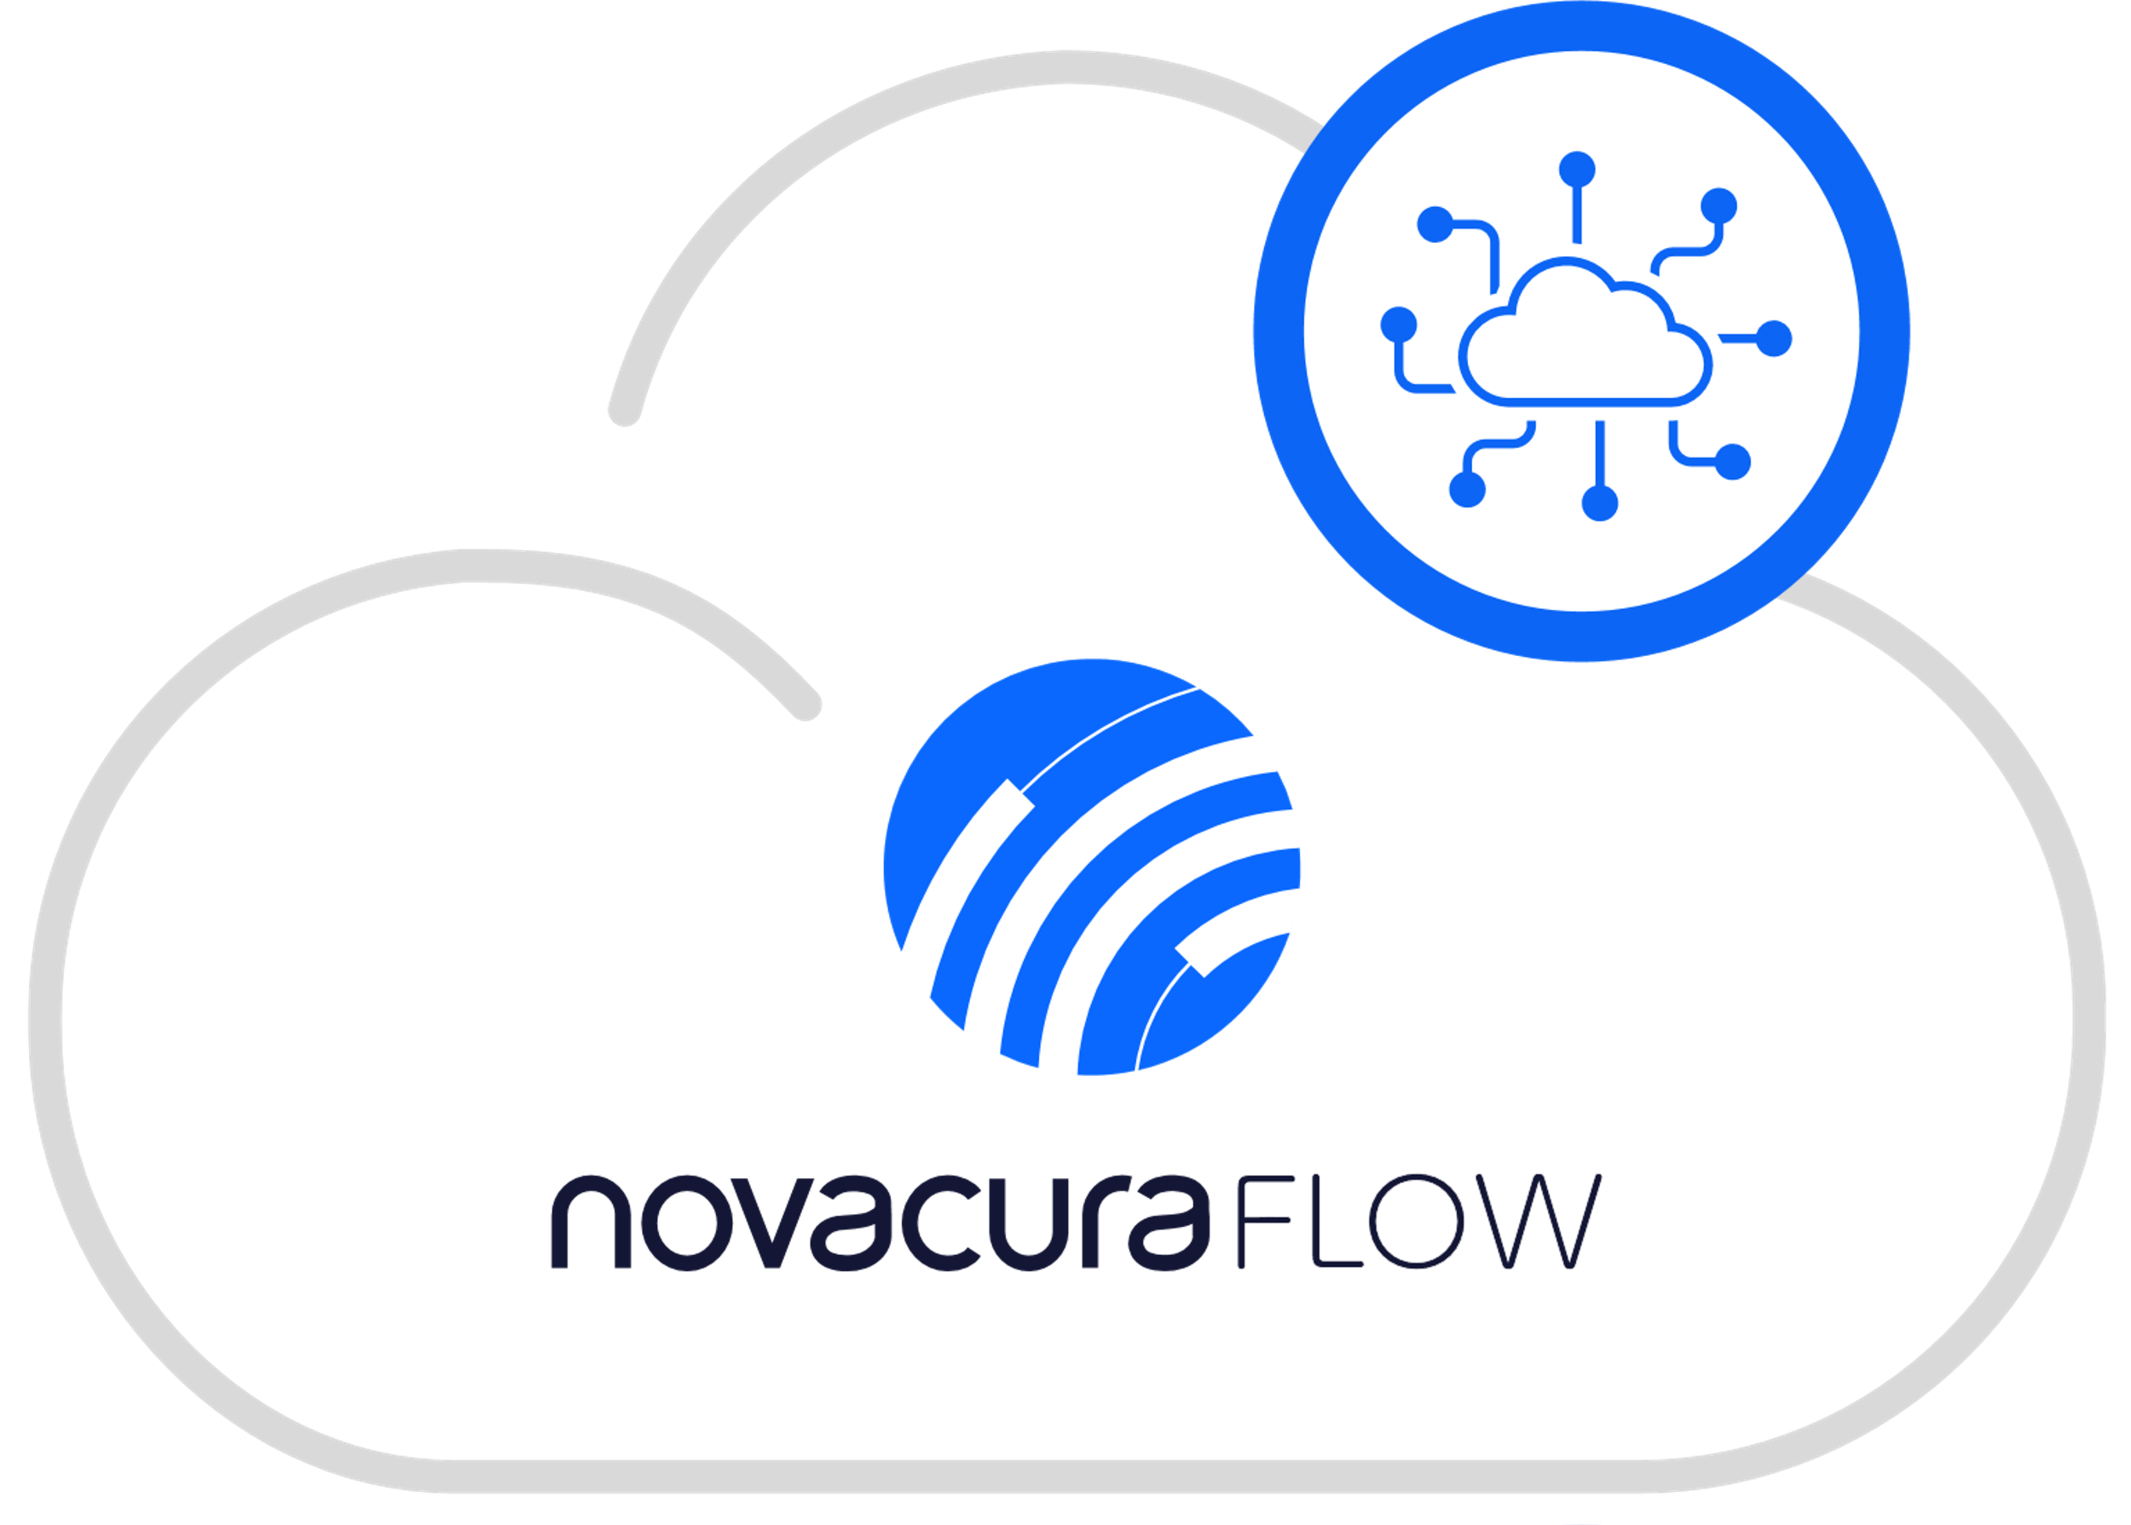
SERVICES FOR NOVACURA FLOW
We help our customers design and implement their first solutions and applications, we offer a complete package of Application Management Services (AMS) that may include solution support, technical administration, monitoring and development services. For customers who want to build apps independently, we offer training and certification services.
Novacura Flow can be offered in a SaaS model, where all necessary IT infrastructure and IT administration are managed by Novacura.

